Slide 1


True Benefit of Electric Vehicles
Team: Richard, Abdoul, Mandler, Alexandra, Zac
Is the movement towards electric vehicles truly a benefit
To the planet and people (2015 – 2018)
Questions to answer:
What is/has been the impact on Carbon Dioxide emissions? – Mandler, Alex
Who owns Evs? – Abdoul, Zac
Does one type of climate provide better conditions for EV ownership vs total car sales? – Richard, Zac
Datasets and APIs
Census, Google Maps, OpenWeatherMap, Alliance for Automotive Innovation

Slide 2
Electric Vehicles
Impact on Carbon Emissions
Census data v median household income
Regional climates and EV sales

Slide 3
Ownership of Electric Vehicles
Median household income of families with EV
What areas own the most (Cost of Living)

Slide 4
EVs Sold vs Ave Median Household Inc
Notes:
California is the high dot, Florida is next. Upward trend with Median Household Income vs Numbers sold, but the states with the highest EVs does not match up with States with the highest HMI

Slide 5
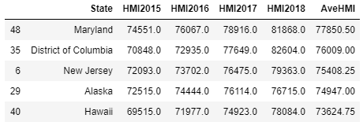
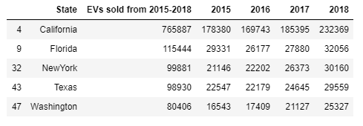
Top 5 States in Sales and Median Household Income
Top 5 lists do not share any common states
No perceived correlation between state HMI and Evs owned

Slide 6
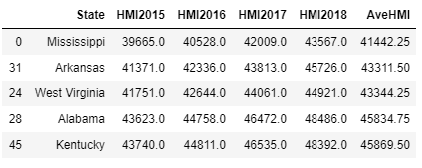
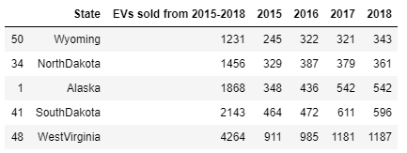
Bottom 5 States in Sales and Median Household Income
Bottom 5 lists do not share any common states
No perceived correlation between state HMI and Evs owned
Notes:
Scatter plot is deceiving as 50/51 states are clustered in a nice linear format (California being the exception)

Slide 7
Car Sales vs Weather Conditions
Do prevailing weather conditions impact EV sales
What weather conditions predominate EV population

Slide 8

Electric Vehicle Sales and Climate
A look into different climates of the United States of America.
Is there a correlation?

Slide 9
Climates Available in the United States
A - Tropical Climates
In these climates all months have average temperatures greater than 64°F (18°C) and annual precipitation greater than 59".
C - Moist Subtropical Mid-Latitude Climates
Generally has warm and humid summers with mild winters. Its extent is from 30°50° of latitude mainly on the eastern and western borders of most continents.
H – Highlands
Unique climates based on their elevation. Highland climates occur in mountainous terrain where rapid elevation changes cause rapid climatic changes over short distances.
B - Dry Climates
These climates extend from 20°-35° North and South of the equator and in large continental regions of the mid-latitudes often surrounded by mountains.
D - Moist Continental Mid-Latitude Climates
Moist continental mid-latitude climates have warm to cool summers and cold winters. The location of these climates is poleward of the "C" climates. The average temperature of the warmest month is greater than 50°F (10°C), while the coldest month is less than -22°F (-30°C).
Data Source: https://www.weather.gov/jetstream/climates

Slide 10





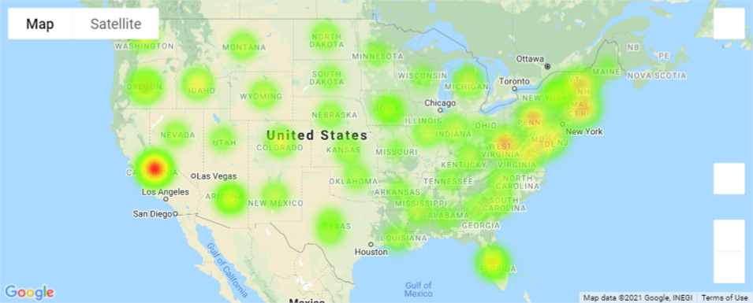
EV Sales Across the US
All 50 States have EV sales ranging from 0.95% to 9.81% of the Market Share of Cars.

Slide 11
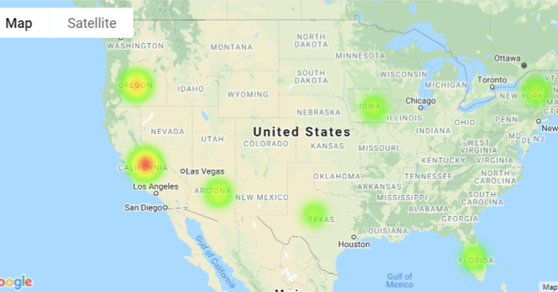
A look at a small sample of States
What analysis can we take a look at?

Slide 12

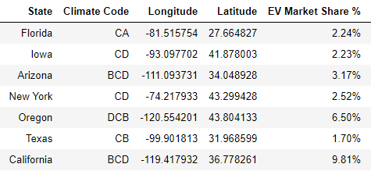

Slide 13
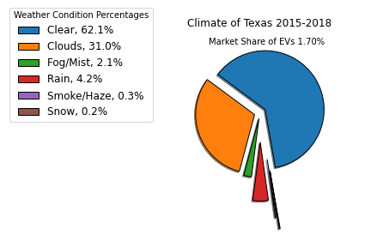
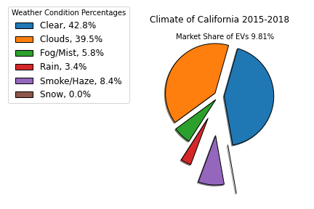
Lowest vs highest EV Market Shares
CB
BCD

Slide 14
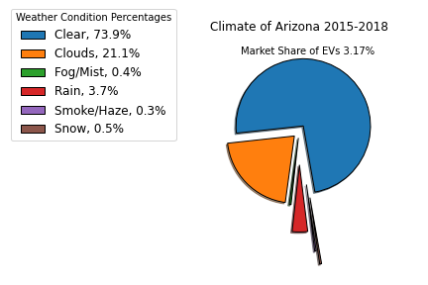
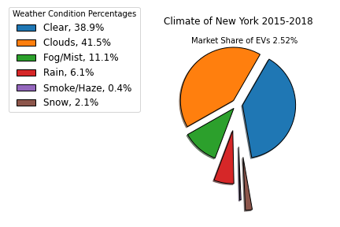
West and East
BCD
CD

Slide 15
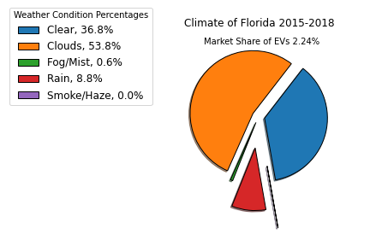
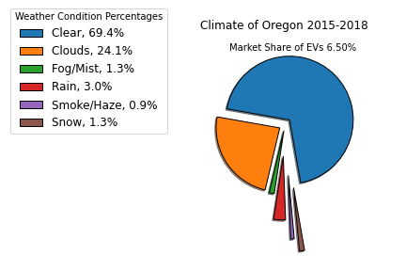
A Hot vs Cold Climate
CA
DCB

Slide 16
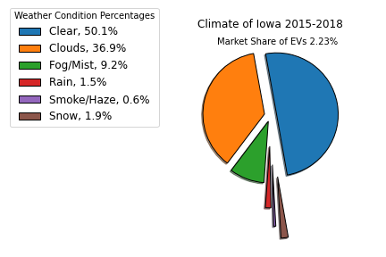
Somewhere in the Middle
CD

Slide 17
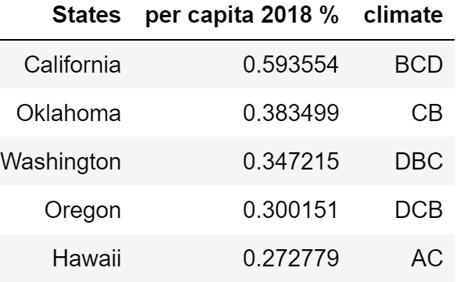
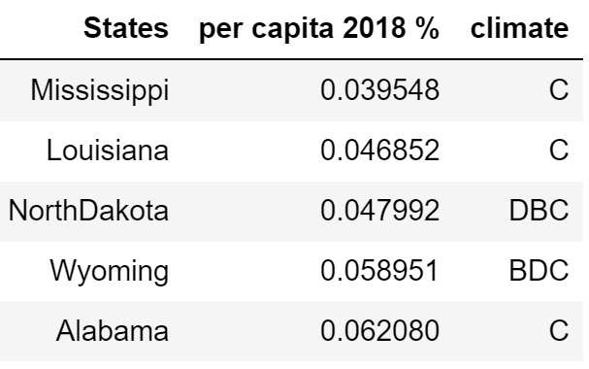
Top Five Per Capita (High and Low 2018)
Top Five Highest
Top Five Lowest

Slide 18
Impact of Carbon Emissions
Has the sale of EVs lowered Carbon Emissions?
If so, by how much?
Has the production of electricity raised Carbon Emissions?

Slide 19
Take Aways
Move from analyzing based on State level to City/County level.
Rural vs Urban areas could have a drastic difference in HMI and EV ownership
California as an outlier is affecting the trend, still positive, but not as drastic as scatter plot indicates

